Slide 1


Slide 2
AGENDA:
Problems faced by farmers.
What are the solutions that others had given in past.
What are solutions that we are going to provide them .
Application demo.
Crop details.
Insurance.
Agro tips.

Slide 3
Problems faced by farmers:
The main problem that we are concerned is about the sale of crops to the dealers.
General market rates which are provided by Government are not totally implemented at root level.
So to over come this problem we are developing this application for the benefits of farmers and our future generations.

Slide 4
What are the solutions that others had given in past:
In past govt. has started some committees in India to overcome this problem.
But it is not implemented all over the state due to the lack of knowledge of farmers and few inconveniences.

Slide 5
What are solutions that we are going to provide :
Our application consists of a basic entry for any user without any login but the dealers have to login as a dealer .In the Crops section the dealer’s crop rates information is stored in the database and displayed when the farmer is searching for the best deal . All the dealers list is displayed for him.The dealer is allowed to update the prices when the updates are to be done .In the Insurance section, the insurance of every crop is given and is updated in database periodically when there are any variations. In Agro-tips ,the farmers are given the best tips for the good crops and disease preventive measures.

Slide 6
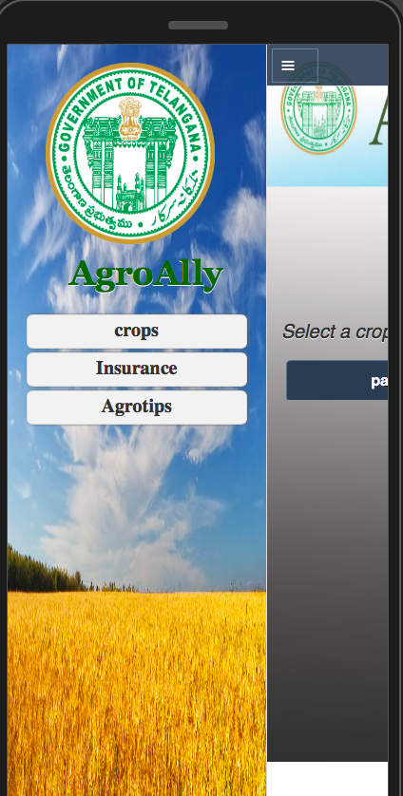
APP Demo:
The facilities which we are providing in our app…

Slide 7

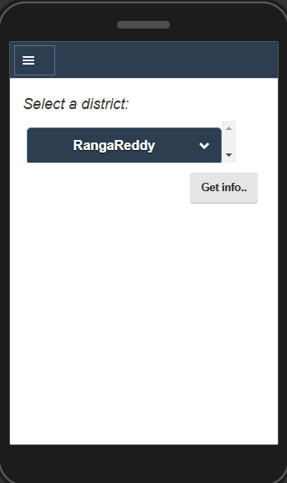
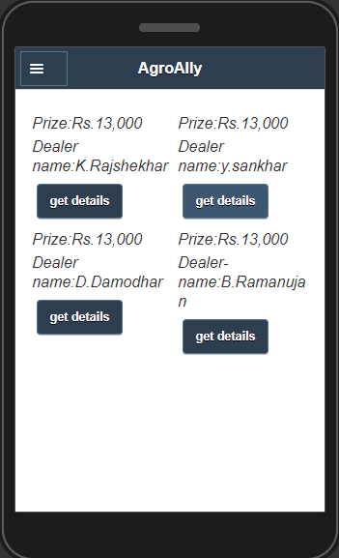
Crop details:
First farmer will enter into the crops and then he move into the district then the prices of the crop in that district will be shown in the app.

Slide 8
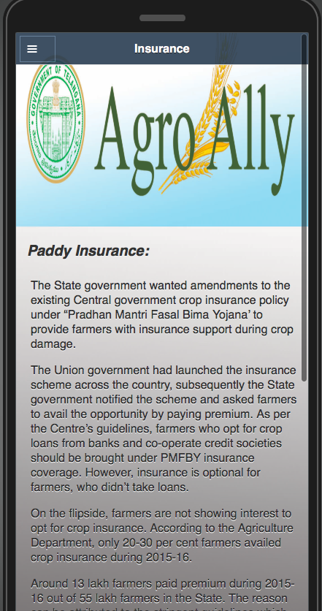
Insurance:
In this the periodical update of the amount that the government has provided to the crop will be updated.

Slide 9
Agro tips:
Different suggestions like fertilizers , crop rotation ,etc. are provided to the farmers .
The agricultural officers give these details regarding fertilizers, crop to be grown etc.

Slide 10
Any Queries???

Slide 11
THANK YOU...

